Slide 1
Pycon Uganda 23

Slide 2
Python Customs Visuals with Power Bi:
Unleashing the Power Of Data Visualization

Slide 3
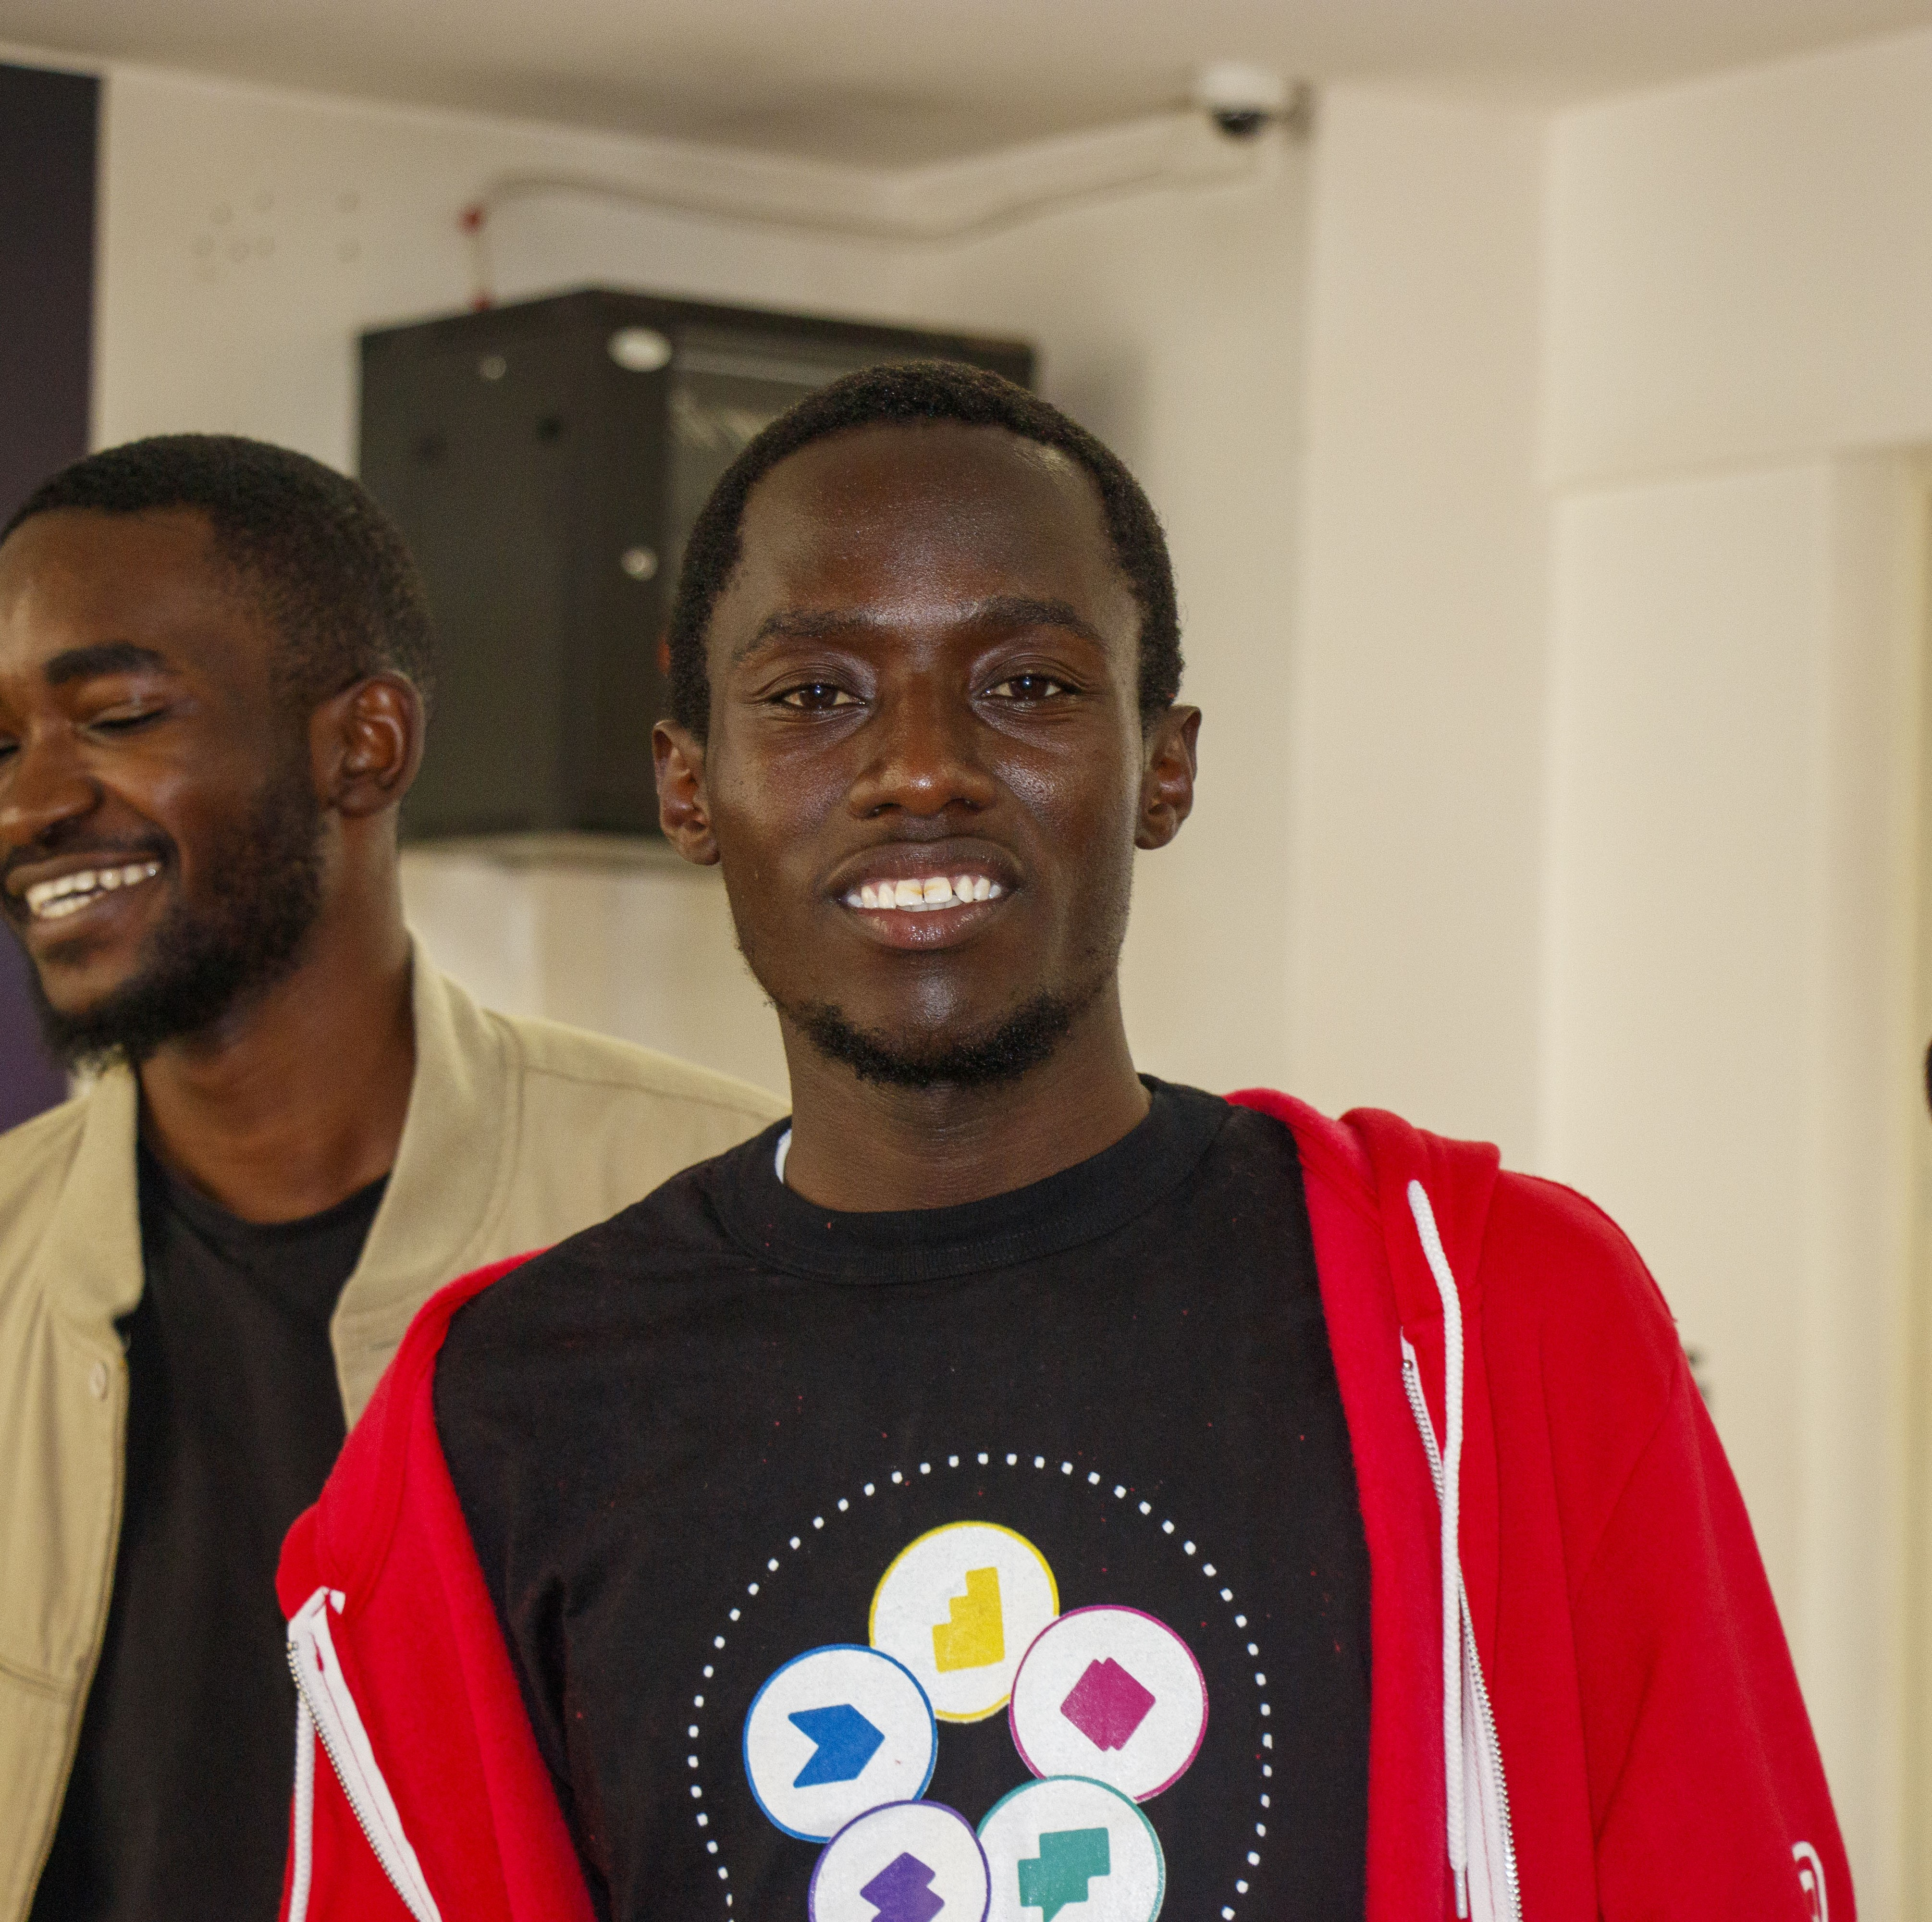
Who Am I
Allan Kiche
Developer – Populations Service International – PSI
5th Year Student – Moi University
Community Advocate – Github Campus Expert
Socials
X – Formerly Twitter - @kiche_allan
LinkedIn - kiche-allan

Slide 4

Pycon Uganda
Data visualization is the graphical representation of data to help people understand the significance of data by displaying it in a visual context.
It involves creating visual depictions of data through charts, graphs, maps, and other visual elements.
What is Data Visualization
Notes:
GitHub Copilot is an AI pair programmer that helps developers write code faster with less work.

Slide 5
Pycon Uganda
The primary goal of data visualization is to communicate information clearly, concisely, and effectively, making complex data more accessible and understandable.
Goal
Notes:
GitHub Copilot is an AI pair programmer that helps developers write code faster with less work.

Slide 6
Pycon Uganda
Power BI, short for "Power Business Intelligence," is a suite of business analytics tools developed by Microsoft. It is designed to help organizations transform their data into actionable insights, enabling data-driven decision-making. Power BI is widely used for data visualization, business intelligence, and reporting purposes
What is Power Bi
Notes:
GitHub Copilot is an AI pair programmer that helps developers write code faster with less work.

Slide 7

Limitations of Inbuilt Power Bi
POV – Only add a feature when its absolutely necessry
Notes:
This demo shows a mood to color converter. We can type in a description of like “a blue sky at dusk”, “playing with a basketball”, “or gazing at the golden sunflowers”, and Open AI will generate a hex color code for us.

Slide 8
Pycon Uganda
Limited Customizable Options
Built-in PowerBI visuals offer limited customization in terms of formatting, style, and interactivity. Users often find it challenging to fine-tune visuals to match specific.
Limitations of Built In Visuals
Restricted Chart Types
PowerBI's default visuals provide a predefined set of chart types. If your data requires a specialized or unconventional chart type, you may face limitations in representing your data effectively.

Slide 9
Pycon Uganda
Performance Issues with Large datasets
Built-in visuals might encounter performance issues when dealing with large datasets. This can lead to slower report rendering and user experience problems..
Limitations of Built In Visuals
Complex Data Transformation
Users may struggle to create custom calculations or aggregations within the visual itself when handling complex data

Slide 10

POV – Only add a feature when its absolutely necessary
Notes:
This demo shows a mood to color converter. We can type in a description of like “a blue sky at dusk”, “playing with a basketball”, “or gazing at the golden sunflowers”, and Open AI will generate a hex color code for us.

Slide 11

Pycon Uganda
Why Use Python Custom Visuals
Notes:
Many people incorrectly assume that OpenAI's models are continuously learning & improving based on their interactions with the service. While that would be pretty cool, it's just not feasible today. In fact, it's more like OpenAI burns the models onto a CD-ROM. The models are trained once, then "locked" in place until they're trained again.
For example, Sahara base (ChatGPT 3.5-turbo) was originally trained in early 2022. Then updated in March 2023

Slide 12
Pycon Uganda
Why Use Custom Python Visuals
Limitations of Inbuild Power Bi
Integration with Data Analytic Tools
Python's powerful libraries like Matplotlib, Seaborn, and Plotly can enhance your data insights.
Dynamic Data Visualization
Python customs visuals can create dynamic, interactive visualizations that can adapt to changing data, making them perfect for real-time or dynamic data scenarios
Notes:
Today, it’s using a model called sahara-base (a.k.a. ChatGPT 3.5-turbo). Sahara-base optimizes for both response quality and latency, with acceptable compromises around cost.
Cost
To run GitHub Copilot, we need GPUs. GPUs are expensive and hard to find. When Copilot runs in the code editor, we open a streaming connection from the code editor to the most expensive class of GPUs available.
Latency
is the measured by time to deliver a response. Anything slower than 500ms makes the service feel “laggy”, and ruins the developer’s flow
Response Quality
as measured by (a) # suggestions delivered, (b) % suggestions accepted, and (c) % code written by AI. We want that a high number of suggestions accepted so that Copilot is providing suggestions that developers like rather than distracting them

Slide 13
Pycon Uganda
Why Use Custom Python Visuals
Industry-Specific Needs
Custom visuals allow you to build visualizations that cater to the specific needs of your industry. For example, financial institutions might need specialized visuals for tracking stock market data, while healthcare organizations might require visuals for patient outcomes.
Data StoryTelling
Tell compelling data stories through a narrative, making it easier for them to understand the data and draw meaningful insights.
Notes:
Today, it’s using a model called sahara-base (a.k.a. ChatGPT 3.5-turbo). Sahara-base optimizes for both response quality and latency, with acceptable compromises around cost.
Cost
To run GitHub Copilot, we need GPUs. GPUs are expensive and hard to find. When Copilot runs in the code editor, we open a streaming connection from the code editor to the most expensive class of GPUs available.
Latency
is the measured by time to deliver a response. Anything slower than 500ms makes the service feel “laggy”, and ruins the developer’s flow
Response Quality
as measured by (a) # suggestions delivered, (b) % suggestions accepted, and (c) % code written by AI. We want that a high number of suggestions accepted so that Copilot is providing suggestions that developers like rather than distracting them

Slide 14
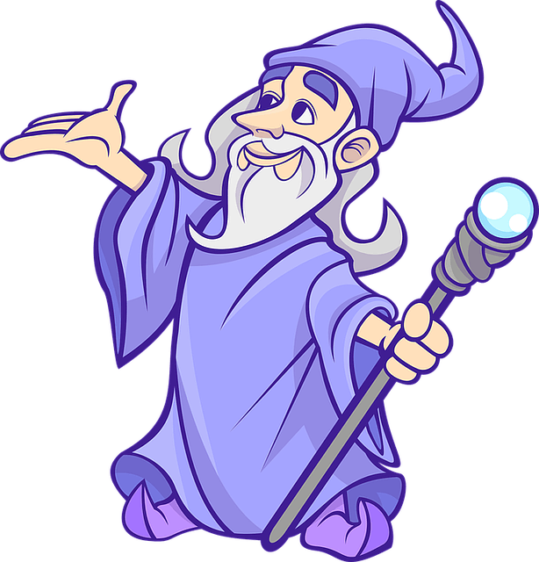
Pycon Uganda
That’s combining 2 powerful tools for Data Visualization
Is it magic?
Notes:
We use the terms “AI pair programmer” and “Copilot” to imply that this tool cannot work without you–the developer! It’s not magic. It cannot read minds, although it sometimes feels like it can. However, by sharing code completion suggestions based on my project’s context and style conventions, GitHub Copilot increased my velocity and confidence as a programmer.

Slide 15
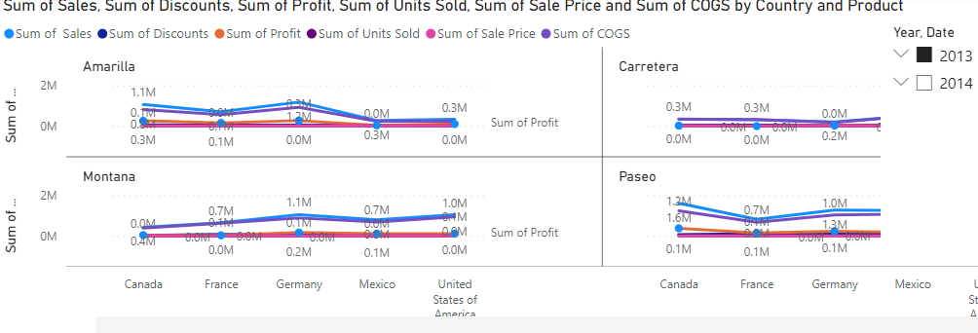
Notes:
In this image, we’re looking at some colored lines of code and some grey lines of code. The colored lines are code that a developer has written. While the grey text is the suggestion that GitHub Copilot makes. We call this text – ghost text. In this image, GitHub Copilot is suggesting unit test code that tests if a book on a web application returns a title with or without a subtitle.

Slide 16
import pandas as pd
import matplotlib.pyplot as plt
# Assuming you have already loaded your data into a DataFrame named 'dataset’
x1 = dataset['Country’]
y1 = dataset['Sum of Sales’]
y2 = dataset['Sum of Discounts’]
y3 = dataset['Sum of Profit’]
plt.plot(x, y1, 'o-', color='green', label='Sales’)
plt.plot(x, y2, '--o', color='tomato', label='Discounts’)
plt.plot(x, y3, '^', color='blue', label='Profit’)
plt.xlabel('Country') plt.ylabel('Values’)
plt.title('Sales, Discounts, and Profit by Country’)
plt.legend()
#Display the legend to label the lines
plt.xticks(rotation=45)
# Rotate x-axis labels for better readability plt.tight_layout() plt.show()
Notes:
In this image, we’re looking at some colored lines of code and some grey lines of code. The colored lines are code that a developer has written. While the grey text is the suggestion that GitHub Copilot makes. We call this text – ghost text. In this image, GitHub Copilot is suggesting unit test code that tests if a book on a web application returns a title with or without a subtitle.

Slide 17
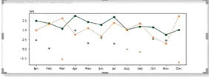
Notes:
In this image, we’re looking at some colored lines of code and some grey lines of code. The colored lines are code that a developer has written. While the grey text is the suggestion that GitHub Copilot makes. We call this text – ghost text. In this image, GitHub Copilot is suggesting unit test code that tests if a book on a web application returns a title with or without a subtitle.

Slide 18







Thank You
Uganda
Notes:
While GitHub Copilot can boost productivity for your team’s most senior developers, it can also provide psychological safety to your most junior developers.
Psychological safety refers to the belief that you can speak up, ask questions, make mistakes, and contribute without fear of punishment or humiliation. When employees feel safe to learn, ask questions, contribute, and lead, it boosts the team’s and individual’s overall confidence, morale, and performance.
Unfortunately, the reality is psychological safety is not always common at work, especially in the tech industry, especially for minorities.
In addition to asking teammates questions, as any collaborative engineer does, beginner developers can have more reassurance from GitHub Copilot that they’re going in the right direction. It acts as a peer providing them with multiple suggestions and ideas when using a new tool or API for the first time, or they’re not sure which direction they should take.

